Slide 1
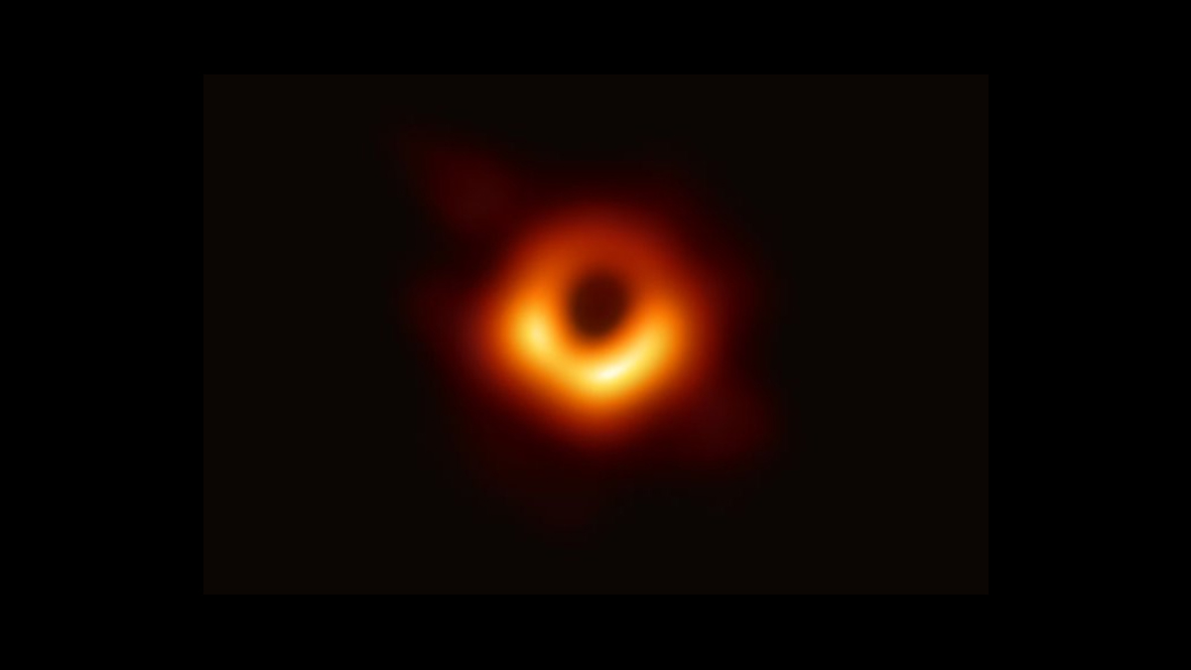
BLACK HOLE SYSTEMS
Jarrod Hansen, RJ Cass

Slide 2

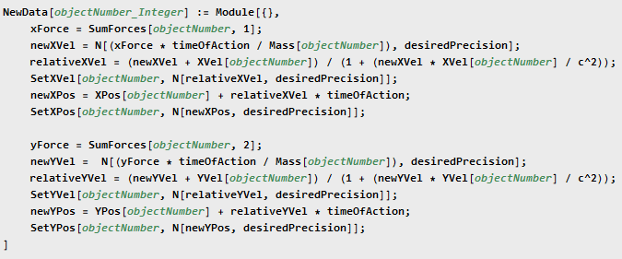
Code
Helper Functions
Calculating Functions
Processing Functions
Display / Export Functions

Slide 3
Stable system: Orbits and Gravitational Potential

Slide 4
4 Body System: Inherent Instability

Slide 5
4 Body System: Gravitational Potentials

Slide 6
Star Ejection:

Slide 7
Boredom Likes Friends

